Slide 1
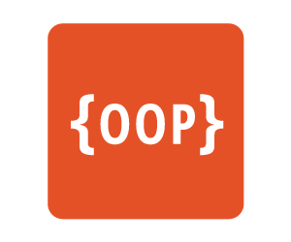
Object Oriented Programming

Slide 2
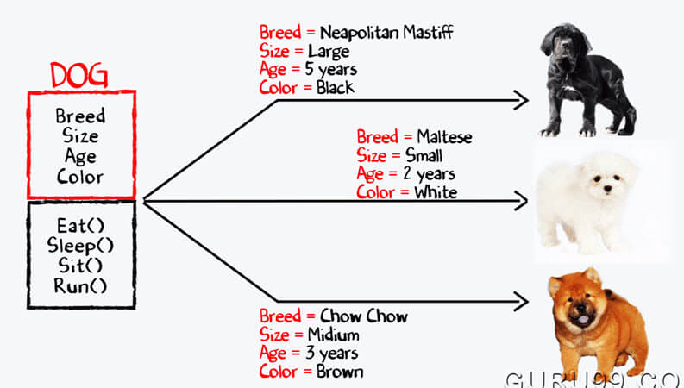
What Is OOP…?

Slide 3
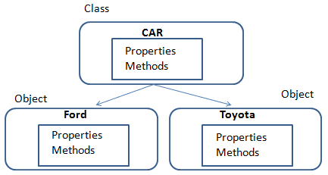
Class, Object, …?

Slide 4
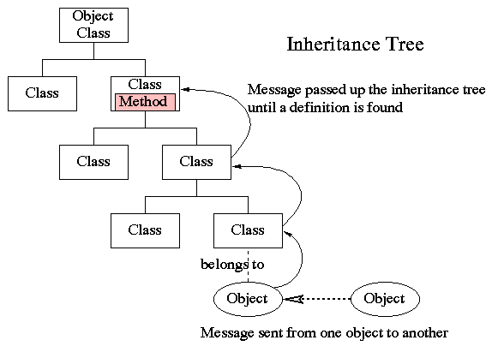
Inheritance Architecture

Slide 5
4 Principal of OOP
1 - Encapsulation
2 - Abstraction
3 - Inheritance
4 - Polymorphism

Slide 6
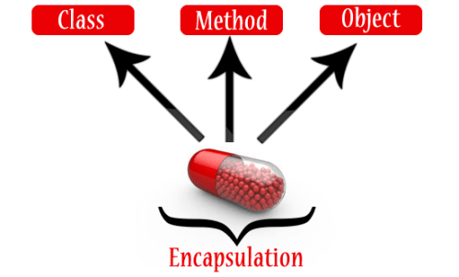
1 - Encapsulation

Slide 7
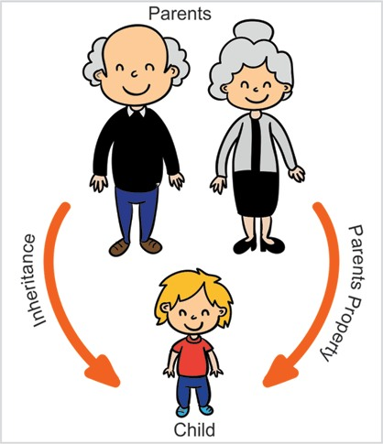
2 - Inheritance

Slide 8
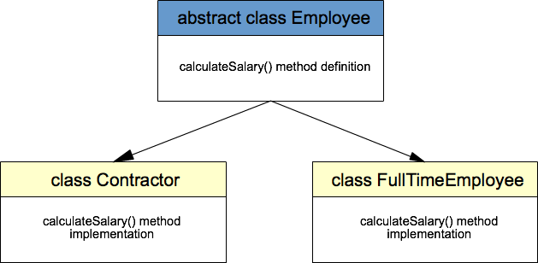
3 - Abstraction

Slide 9
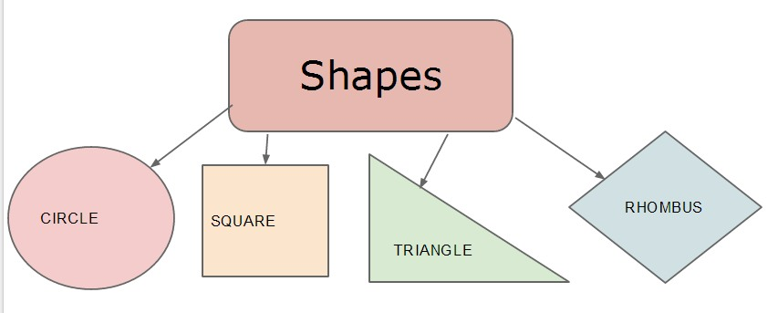
4 - Polymorphism

